Slide 2
DATAs
Logical arrangements of information to be process by the computer
Set of information's in binary format
facts that can be analyzed or used in an effort to gain knowledge or making decisions

Slide 3
Processors
8080 – 8 bit
8086 -16bit
32 bit
64 bit
X86 –family 32+64 = 82
64 – 32bit application and 64 bit application
32 bit – 32 bit application
2012 -> 128bit

Slide 4
Storage Devices
Punch card – 80 character
Magnetic tapes – Expensive storage device
Floppy drive -1.8 mb
Flash storages -
CD/DVD Drives 700- 800 4-16
Magnetic Drive
SSD

Slide 5
Types of data
Structured – Data's will be aligned in row and column format, instead of using processor for searching mechanism they came up with database engine
Ex: Database
Unstructured -> it doesn’t have any specified for to align , Unsorted searching, priority folder and files
Semi-Structured -> Data's will be aligned in row and column format
Ex: Excel, XML, Json

Slide 6
Structured Data
rollno | name | s1
1 | a | 40
2 | b | 50
3 | c | 60
4 | d | 70

Slide 7
Semi-Structured Data
rollno | name | s1
1 | a | 40
2 | b | 50
3 | c | 60
4 | d | 70

Slide 8
RDBMS
Amazon Aurora
MYSQL
Microsoft SQL
Oracle
Postgres
MariaDB

Slide 9
MySQL
MySQL is the most popular open source database in the world. MySQL on RDS offers the rich features of the MySQL community edition with the flexibility to easily scale compute resources or storage capacity for your database.
Supports database size up to 64 TiB.
Supports General Purpose, Memory Optimized, and Burstable Performance instance classes.
Supports automated backup and point-in-time recovery.
Supports up to 5 Read Replicas per instance, within a single Region or cross-region.

Slide 10
MariaDB
MariaDB Community Edition is a MySQL-compatible database with strong support from the open source community, and extra features and performance optimizations.
Supports database size up to 64 TiB.
Supports General Purpose, Memory Optimized, and Burstable Performance instance classes.
Supports automated backup and point-in-time recovery.
Supports up to 5 Read Replicas per instance, within a single Region or cross-region.
Supports global transaction ID (GTID) and thread pooling.
Developed and supported by the MariaDB open source community.

Slide 11
PostgreSQL
PostgreSQL is a powerful, open-source object-relational database system with a strong reputation of reliability, stability, and correctness.
High reliability and stability in a variety of workloads.
Advanced features to perform in high-volume environments.
Vibrant open-source community that releases new features multiple times per year.
Supports multiple extensions that add even more functionality to the database.
Supports up to 5 Read Replicas per instance, within a single Region or cross-region.
The most Oracle-compatible open-source database.

Slide 12
Oracle
Oracle Enterprise Edition
Efficient, reliable, and secure database management system that delivers comprehensive high-end capabilities for mission-critical applications and demanding database workloads.
Oracle Standard Edition
Affordable and full-featured database management system supporting up to 32 vCPUs.
Oracle Standard Edition One
Affordable and full-featured database management system supporting up to 16 vCPUs.
Oracle Standard Edition Two
Affordable and full-featured database management system supporting up to 16 vCPUs. Oracle Database Standard Edition Two is a replacement for Standard Edition and Standard Edition One.

Slide 13
Microsoft SQL Server
SQL Server Express Edition
Affordable database management system that supports database sizes up to 10 GiB.
SQL Server Web Edition
In accordance with Microsoft's licensing policies, it can only be used to support public and Internet-accessible webpages, websites, web applications, and web services.
SQL Server Standard Edition
Core data management and business intelligence capabilities for mission-critical applications and mixed workloads.
SQL Server Enterprise Edition
Comprehensive high-end capabilities for mission-critical applications with demanding database workloads and business intelligence requirements.

Slide 14
CLUSTER – GROUP of computer
Instead of achieving the task on single system – it will consume more and more processing time as well as storage limitations are also there
Group of Computer that can accomplish some particular task as in group of computing resource as well as group of storage resource

Slide 15
Database Operations
Create
Update
Delete
Read

Slide 16
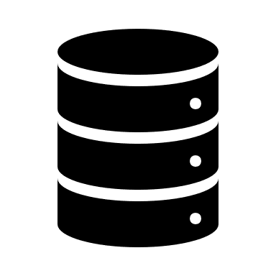


Flipkart
Merchants
Customers

Slide 17
Bank
Customers

Slide 18
OLAP
Online Analytical Processing (OLAP) is a category of software that allows users to analyze information from multiple database systems at the same time. It is a technology that enables analysts to extract and view business data from different points of view.
Recommended: Bigdata
OLTP
If your database is involving more on insert, update, delete operation OLTP
Recommended : Traditional Database

Slide 19
Bigdata industry is not so good for OLTP Data, If you are using OLAP it got well define architecture to handle any volume of data

Slide 20
What is Bigdata?
Big data is a collection of large datasets that cannot be processed using traditional computing techniques.
Data that is not compatible within the systems.
data's beyond exa-bytes/peta bytes

Slide 21
Bigdata is the term for a collection of datasets so large and complex that it becomes so difficult to process or using on-hand database management tools or traditional data processing application.
The challenges include capture, curation, storage, search, sharing, transfer, analysis and visualization

Slide 22
44x increase of data usage from 2009 to 2020
From 0.8 Zettabytes to 35 ZB
Data volume is increasing exponentially day by day
BY 2020, International Data Corporation predicts the number will reach 40,000 EB or 40 ZB
The Entire World information is doubling every 2 years, there will be 52000 GB of data for every person on earth

Slide 23

DB Volume is high it will consume more and more time to process it
1 Gb ram with Dual Core Processor

Slide 24
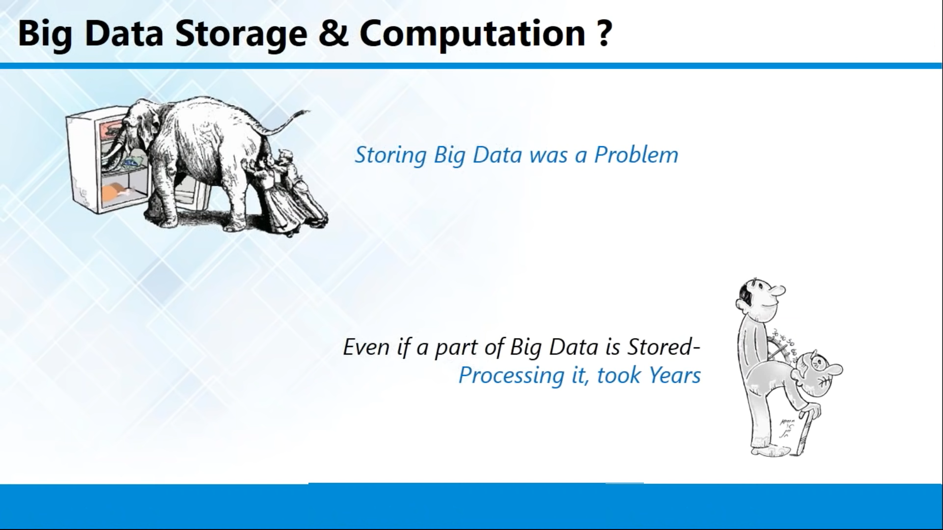

Slide 25
Distributed File System
Bigdata they designed some application that will support for Distributed Computing as well as Distributed storage Mechanism
Distributed computing -> limitation of computing resource, because of single hardware dependency
They designed some application that will run on multiple computers at the same time and fetch those computing resource and use it for single task execution across the cluster.
Distributed Storage -> clustering of storage, that will save the data in multiple systems

Slide 26
100 PB
1000 tb

Slide 27
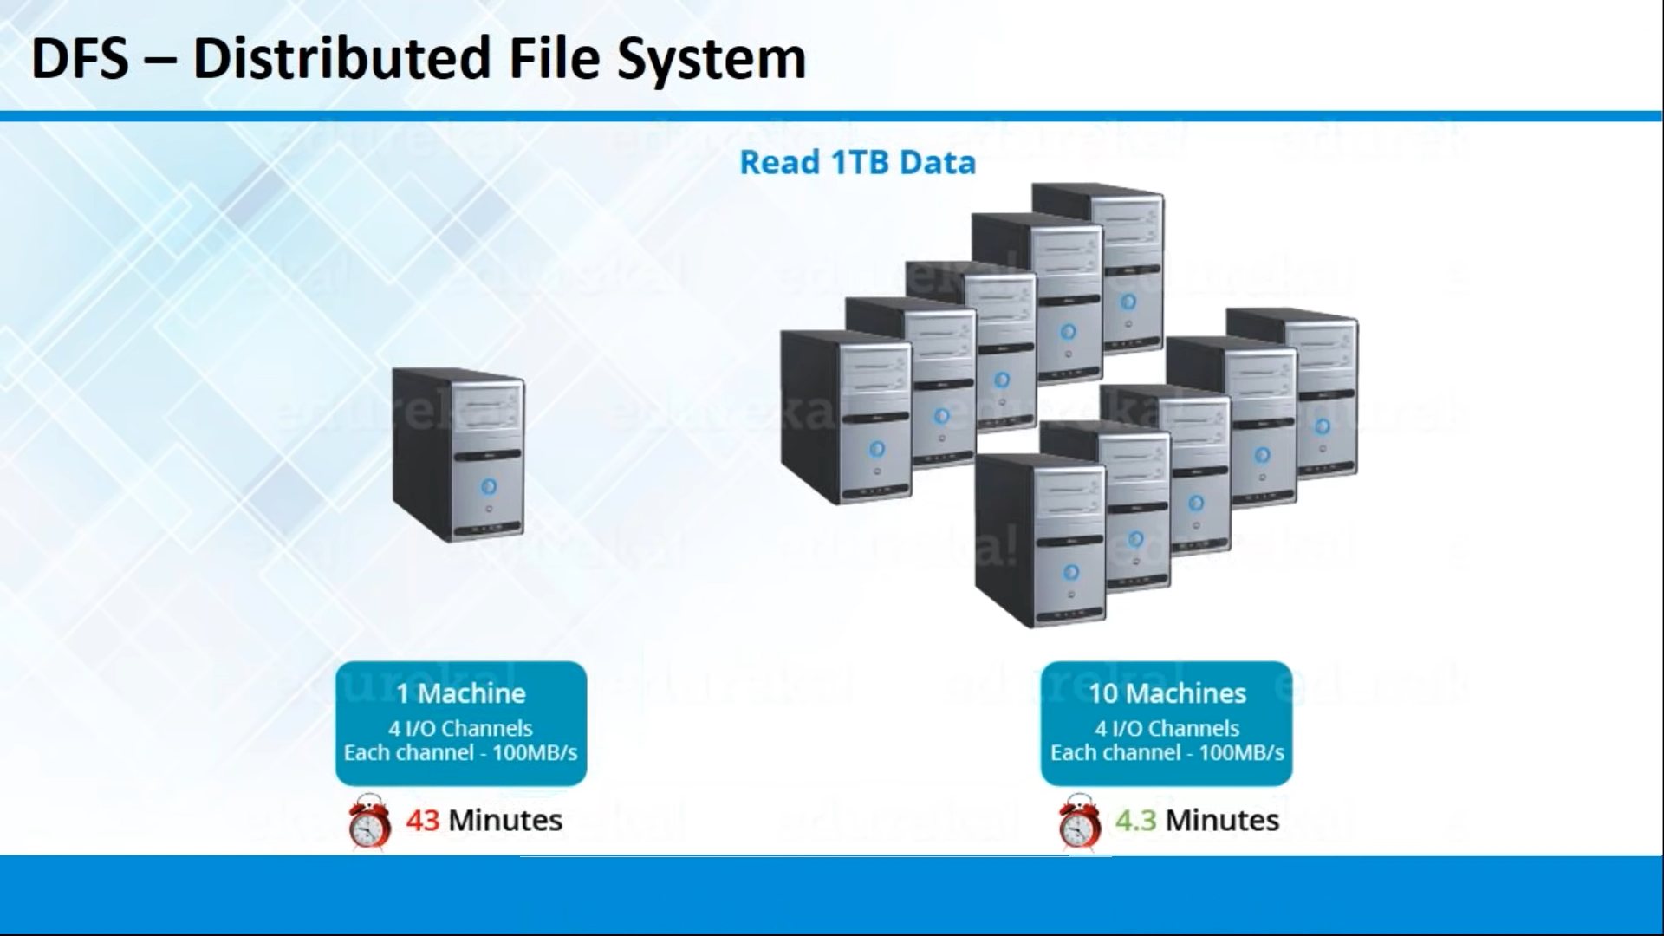

Slide 28
Bigdata
Bigdata designed their application based in distributed processing module
They got their separate distributed processing model as well distributed storage module
They call distributed processing module as MapReduce and they will call the Distributed Storage module as HDFS
Bigdata they will call their architecture as Hadoop Frame Work

Slide 29
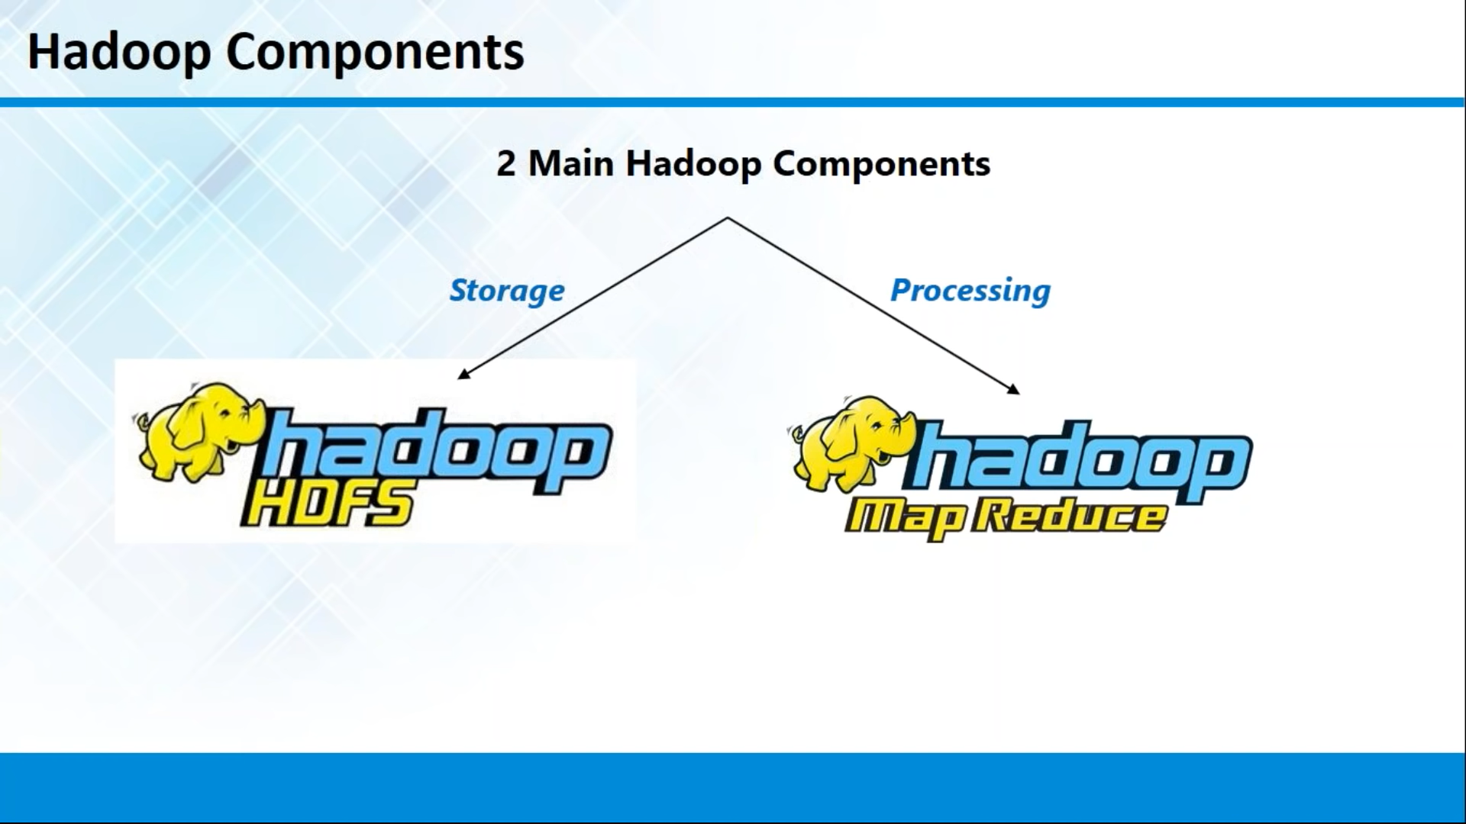

Slide 30
History of Hadoop
In OCT 2003 – google they published their paper Google File System
Dec 2004 - Jeffrey Dean & Sanjay Ghemawat from Google published MapReduce paper called “MapReduce: Simplified Data Processing on Large Clusters”
Jan 2006 - Above MapReduce Paper inspired Doug cutting, a yahoo employee then to develop an open source implementation of MapReduce framework
Jan 2006 - Hadoop subproject created as extension of Apache Nutch project, created by Doug Cutting.
Apr 2006 - Hadoop 0.1.0 released
May 2006 - Yahoo deploys 300 machine Hadoop cluster

Slide 31
History of Hadoop
2008: Cloudera, one of the major distributor of Hadoop founded.
Apr 2007: Yahoo runs 2 clusters of 1,000 machines
Jul 2008: Hadoop wins TeraByte sort benchmark (1st time a Java program won this competition)
Jun 2010: Yahoo 4,000 nodes/70 petabytes
Jun 2010: Facebook 2,300 clusters/40 petabytes
Dec 2011: Apache Hadoop release 1.0.0 available
2011: Hortonworks, another major Hadoop distributor founded
Oct 2013: Apache Hadoop release 2.2.0 (YARN)
Dec 2015: Apache Hadoop release 2.6.3 available
Feb 2016: Apache Hadoop release 2.6.4 available

Slide 32
History of Hadoop
Hadoop is open source frame work -> doesn’t fully supported by windows
Linux – 100% supported OS for Hadoop Framework
Linux -> user friendliness, Cloudera and Hortonworks, they modified the opensource software and they gave some GUI based interface for Hadoop Framework via Webpage

Slide 33
History of Hadoop
Hadoop is a framework that allows distributed processing of large data sets across clusters of commodity computers using simple programming models. Definition In Depth:
Distributed Processing : • Data is processed in multiple machines in a distributed manner
Large Data sets: • Large data sets in this context means files that are hundreds of megabytes, gigabytes, or terabytes in size
Clusters of commodity computers : • Cheap hardware (not expensive servers) are used to create a cluster
Simple Programming Model: • Map Reduce/Spark is used as a programming model to manipulate/process the data

Slide 34
Hadoop Versions
V1.0
Distributed Storage Unit – HDFS
Distributed Computing Unit – MapReduce V1.0
V2.0
Distributed Storage Unit –HDFS
Distributed Computing Unit – YARN and MapReduce V2.0

Slide 35
Hadoop Daemons
Daemons – Background Process
HDFS Daemons
Data Node - Slave
Name Node - Master
MapReduce V1.0
JobTracker - Master
Task Tracker - Slave
MapReduce v2.0/YARN
Resource Manager - Master
Node Manager - Slave

Slide 36
Clustering Model
Master – Slave Architecture
One Master and Multiple Slave Architecture

